Slide 1
SESSIONE 5. DLT e CBDC
Tokenised central bank money settled on DLT
Daniele Di Stazio
Role, ABI
Matthieu Herbeau
CBDC Advisor,
Banque de France
Mauro Attilio Pernigo
Role, Intesa Sanpaolo
Giuseppe Santangeli
Head of Wholesale Payments Division, Banca d’Italia

Slide 2




Why committing to DLT settlement plans? (Matthieu)
In line with its mandate, the Eurosystem is:
Preserving the pivotal role of central bank money in the financial system as safest settlement asset
Supporting the safe development of the ecosystem, with new market needs and market innovation
Maintaining the relevance of the Eurosystem in the emerging technological financial market landscape
Reinforcing the progression towards a digital Capital Markets Union (CMU) and Savings and Investments Union (SIU) in Europe

Slide 3



Eurosystem exploratory work achievements (Matthieu)
Largest initiative of such kind among central banks and successful public-private partnership
64 stakeholders (central banks, commercial banks, CSDs, DLT Pilot Regime applicants) from 11 countries
Unprecedented number of 50+ experiments and trials with wide range of payments, securities use cases covering full value chain beyond settlement
See “Comprehensive overview of trials and experiments”
High-level bond issuances More than 200 real transactions, €1.6 bn settled in six months
Engagement: 12 meetings of NTW-Contact Group and > 40 bilateral/multi-lateral market stakeholder meetings, each use case presented

Slide 4
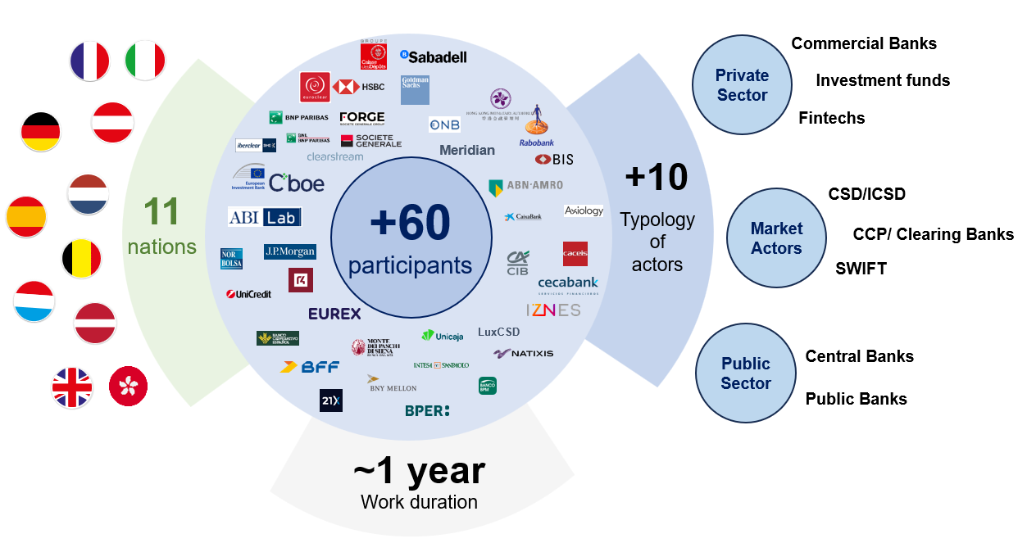
Overview of the exploratory work (Matthieu)

Slide 5

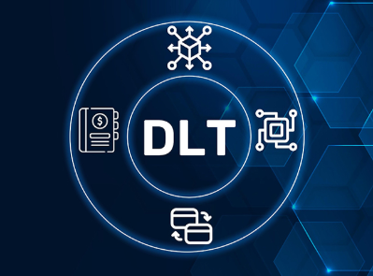

Exploratory work : key findings and learnings (Matthieu)
Availability of tokenized Central Bank Money as a facilitator for DLT adoption
Market demand
Active ecosystem of incumbents and new entrants looking to scale up and grow
Applicable to multiple use cases while offering Central Bank safety
Valuable insights for the design of the future Eurosystem offering leveraging on the merits of the 3 solutions tested
DLT: an opportunity to redesign processes and practices across the value chain
Automation can go beyond settlement
Programmability offers multiple opportunities
Many existing functions in capital markets can be implemented on DLT
Participants tested roles outside of their current remits
Address and overcome shortcomings in today’s ecosystem thanks to DLT
Fragmentation
Complexity
Technological inefficiencies

Slide 6




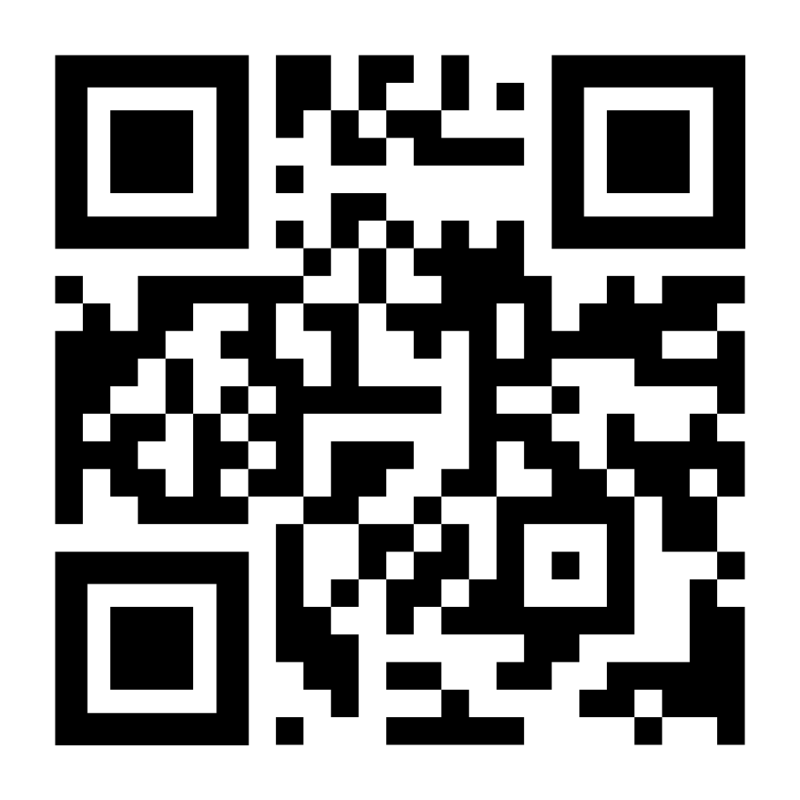
Turning findings into action: dual-track strategy
(Giuseppe)
Exploratory work confirmed market demand and interest for DLT, with an active ecosystem evidenced in Europe
DLT represents an opportunity to redesign processes and practices, including the distribution of roles, across the entire value chain
Pontes
The absence of provision of central bank money is seen as major impediment to the growth of the DLT ecosystem
A move to DLT has the potential to address shortcomings in today’s ecosystem
Appia
Market participants expressed a preference for having a single Eurosystem offering within a short time frame
The active investigation and adoption of DLT is accelerating worldwide
“ECB commits to distributed ledger technology settlement plans with dual-track strategy” (Jul. 2025)

Slide 7
Pontes: scope of a “pilot phase” in 2026
Single and timely Eurosystem offering
One offering combining the features of the interoperability solutions used during exploratory work
Use of DLT for connecting with market DLTs
Settlement of cash tokens on the Eurosystem DLT platform (or in the RTGS component of T2)
Reliable interoperability mechanism
Delivery-versus-Payment (DvP) based on Hash-Link protocol
Settlement finality in T2 RTGS, later through cash token
Final central bank money settlement for the cash leg achieved once the corresponding settlement in T2 is completed
DvP use cases and wholesale payments
e.g. DvP for primary and secondary market operations of eligible assets available on eligible market DLT platforms

Slide 8




Pontes pilot: design overview
Eurosystem DLT with pilot liquidity in a tokenised form for settlement of DLT-based transactions (liquidity will not stay overnight)
Eligible assets
Network Service Providers (NSPs)
T2 Interface
Eurosystem DLT
Extended Interoperability Interface (EII)
= Market DLT(s)
RTGS
ESMIG
Trigger Backend
API Gateway
Central Bank Money
ESY DLT interface
= Market participants
Interface to TARGET Services to automate the interaction with TARGET Services using existing functionalities of T2 RTGS
Interface to the market based on Application Programming Interfaces (APIs)

Slide 9

Potential enhancements in 2028 (under investigation)
Integration in the technical and legal perimeter of the TARGET Services
Single settlement model (tokenized CeBM)
Immediate finality on the tokenised cash leg in CeBM
Possibility to keep liquidity overnight on the Eurosystem DLT
Multi-currency design

Slide 10
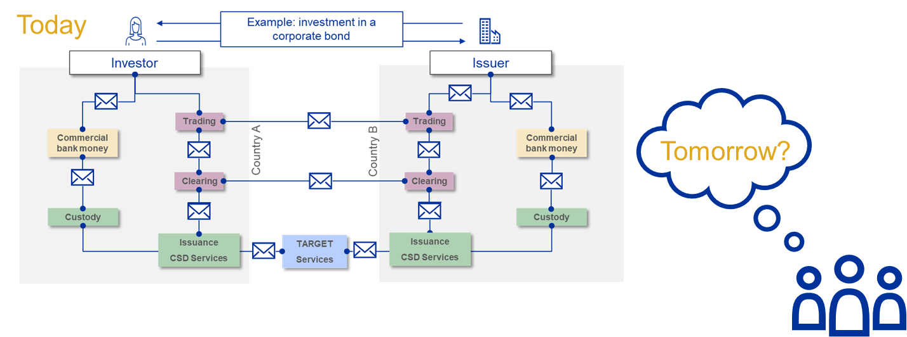
Lont-term vision: can DLT help simplify processes?
(to all panelist - for your contribution)

Slide 11







Appia’s vision – seamless integration?
ECB/NCBs
Issuers
FMIs
Clearing
Ancillary services, other tokenisation use cases
(e.g. real estate, travel industry)
Individual or regional ledgers
Clearing
Clearing
Central bank money settlement
Trading
Trading
Trading
Commercial bank money
Issuance
CSD Services
Commercial bank money
Issuance
CSD Services
Commercial bank money
Issuance
CSD Services
Interoperability with the rest of the world
Interoperability with other DLTs in Europe
Custody
Custody
Custody
Asset managers
Investors
Commercial banks

Slide 12

Appia: a road to a shared ledger or full interoperability?
Key question: Single ledger, interoperable ledgers, or both?
Approach of Appia: Outcome-driven exploration
ECB/NCBs
Issuers
FMIs
Clearing
Clearing
Clearing
Central bank money settlement
Trading
Trading
Trading
Commercial bank money
Issuance
CSD Services
Commercial bank money
Issuance
CSD Services
Commercial bank money
Issuance
CSD Services
See speech by Piero Cipollone “Towards a digital capital markets union” (Oct. 2024)
Custody
Custody
Custody
Commercial banks
Investors
Asset managers

Slide 13
THANK YOU!

